Slide 1

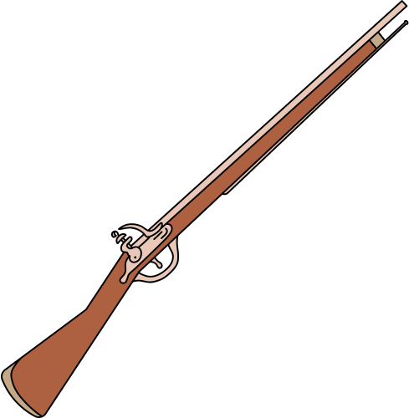


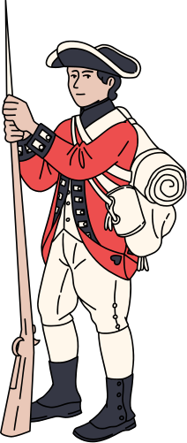
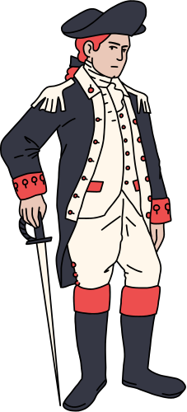





Rizal’s
Life in Europe

Slide 2



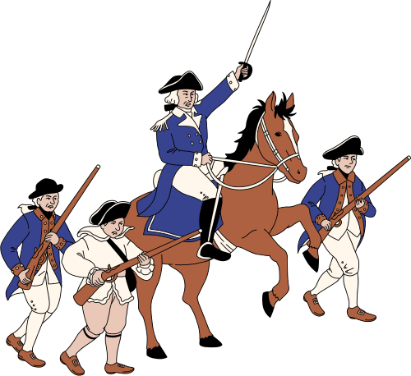
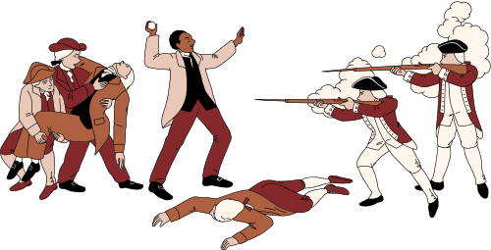
02
May 3, 1882
01
-he left for Spain to complete his studies and to widen his political knowledge through exposure to European governments.
“secret departure”

Slide 3
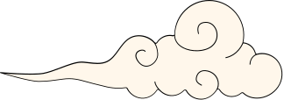

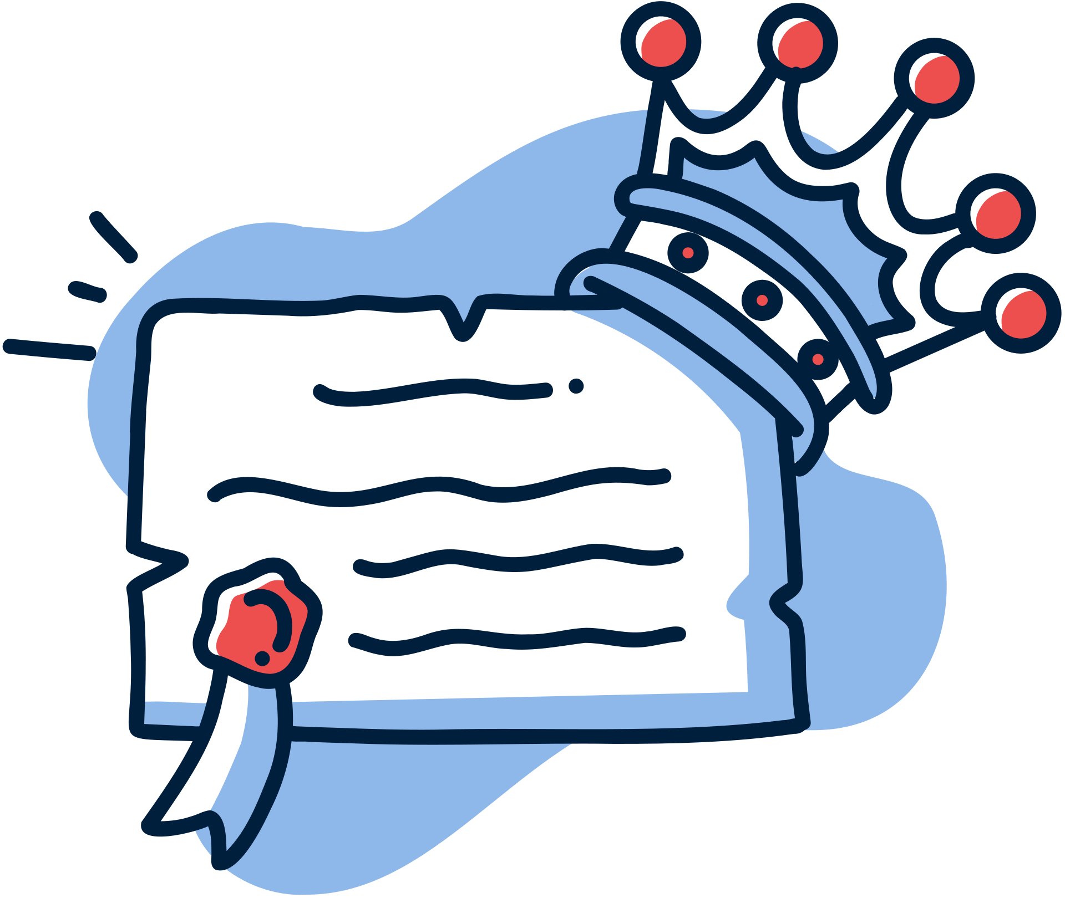
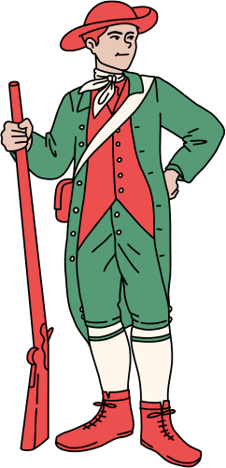
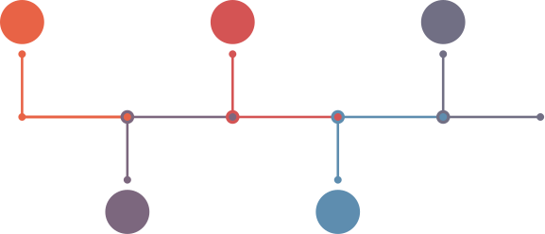


03
In Europe
Singapore -
disembarked & visited
Barcelona
Paris, France
Heidelberg, Germany
Italian
City of Naples
Madrid

Slide 4



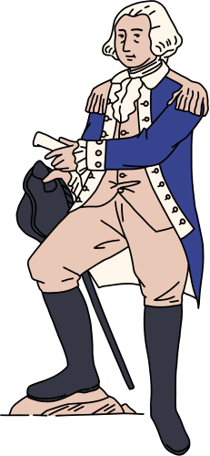

04
Grand Europe Tour
February 21, 1887- he finished his first novel, the Noli and came off to press a month later.
Maximo Viola-loaned him some amount to cover for the printing and paid through Paciano’s remittance.
He decided to further explore some places in Europe before returning to the Philippines.

Slide 5


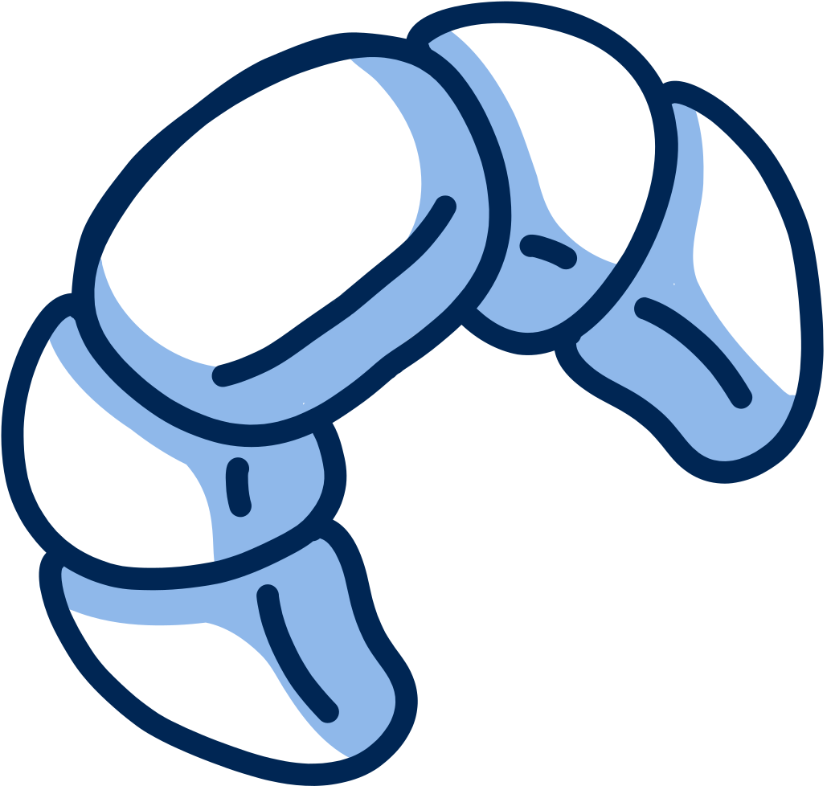

05
Grand Europe Tour
Potsdam- a city southwest
of Berlin
Prague
Munich
Schaffhausen,Basel,Bern, Lausanne
Dresden
Brunn
Nuremberg
Geneva
Leitmeritz, Bohemia
Vienna
Ulm
Turin,MIlan & Florence
Rome (Amphitheatre & Roman Forum)
St. Peter’s Church in Vatican
Leitmeritz, Bohemia
Salzburg
Stuttgart,Baden and Rheinfall

Slide 6


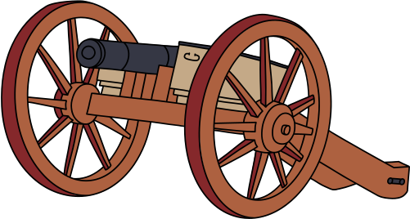

06
First Homecoming
July 3, 1887 - he boarded in Marseilles through the steamer “Djemnah” sailed to the East through Suez Canal and reached Manila near midnight of August 5.
August 8- he returned to Calamba
He restored his mother’s eyesight.
“German doctor” “Doctor Uliman

Slide 7
06
First Homecoming
Rizal was summoned by the Governor General Emilio Terrero assigned bodyguard to Rizal who is Don Jose Taviel de Andrade to protect him from his adversaries.

Slide 8
06
First Homecoming
December 1887- Calamba folks asked Rizal’s assistance in collecting information as regards Dominican hacienda management.
It was in compliance with the order of the government to investiagte the way friar estates were run.

Slide 9
06
First Homecoming
Rizal, objectively reported that the Dominican Order had arbitrarily increased the land rent and charged the tenants nonexistent agricultural services.
Result to:
Friars got enraged and pressured the governor-general to advise Noli’s author to leave the country.
Rizal’s (required) second travel abroad.

Slide 10

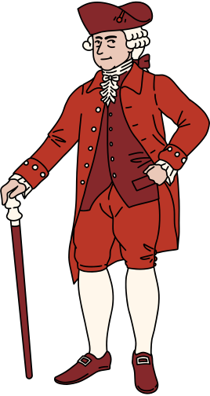
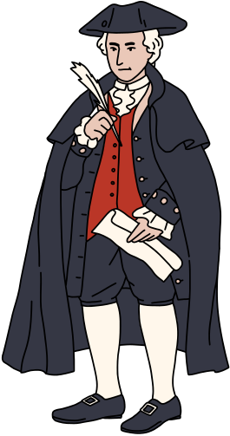
“Thank You Very Much”

